Slide 1
f
By:
TARUN TIWARI
Amazon Sales Data Analysis

Slide 2


Objective:
To understand and analyze Amazon sales data using SQL.
To extract actionable insights for business decision-making.
Agenda:
Overview of the Dataset.
SQL Query Techniques.
Recommendations.
Data Preparation:
Load the dataset into a SQL database.
Handle missing values, remove duplicates, and ensure data consistency.
Ensure that columns have appropriate data types.

Slide 3
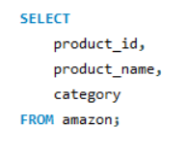
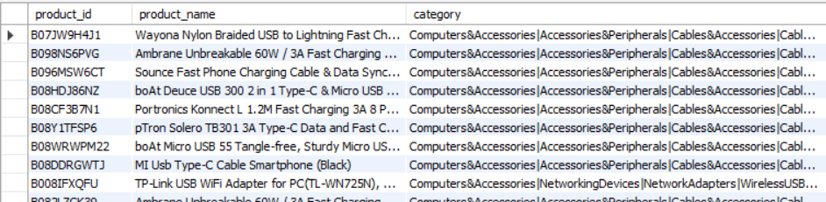
Query to list all products with their product_id, product_name, and category.

Slide 4
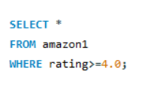
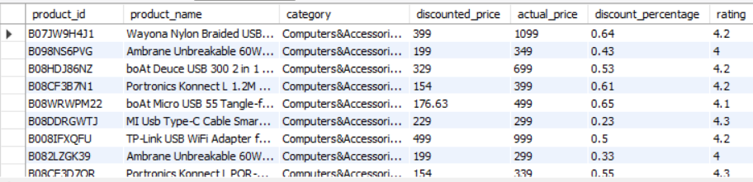
Query to display all columns for products that have a rating of 4.0 or higher.

Slide 5
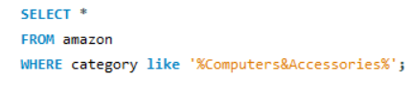
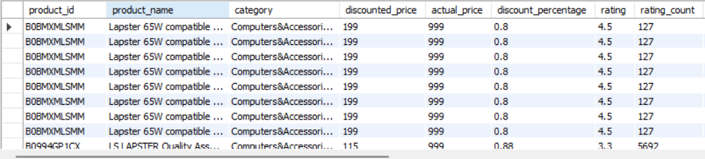
Query to list products that are in the Computers & Accessories category.

Slide 6
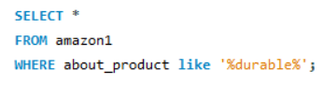
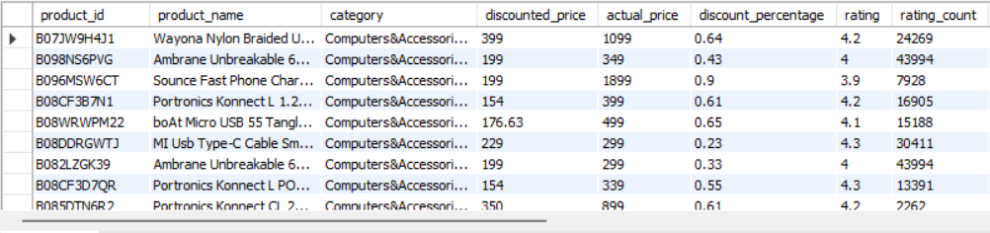
Query to find all products where the about_product column contains the word durable.

Slide 7
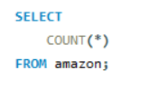

Query to count the total number of products in the dataset.

Slide 8

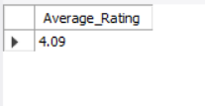
Query to find the average rating of all products.

Slide 9
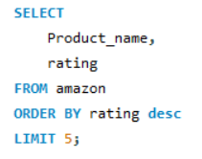
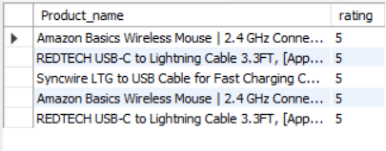
Query to list the top 5 highest-rated products based on the rating, sorted in descending order.

Slide 10

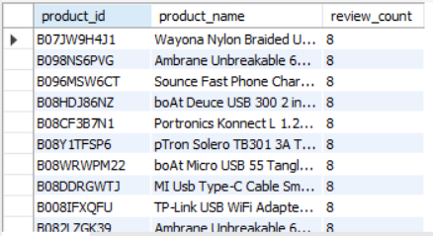
Query to list all products along with the number of reviews they have. Include columns for product_id, product_name, and review_count.

Slide 11
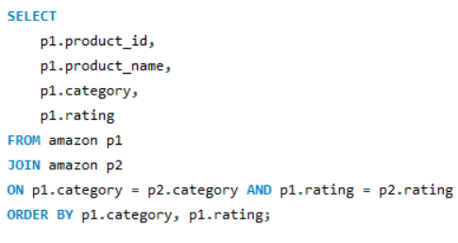
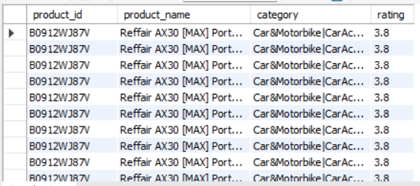
Query to find products that have the same rating and belong to the same category.

Slide 12
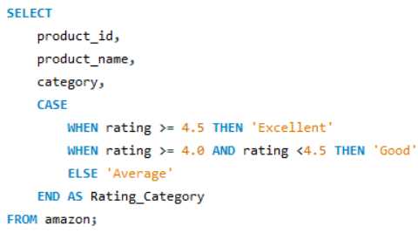
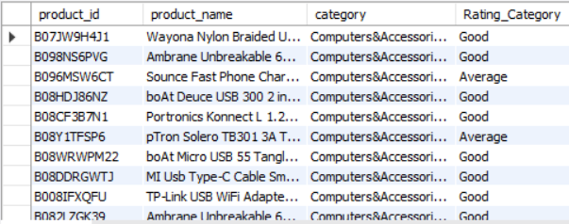
Query using a CASE statement to categorize products into three categories based on their rating.

Slide 13
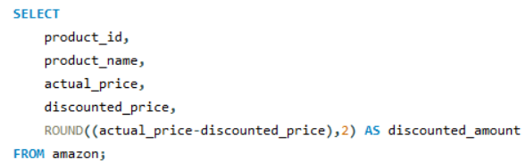
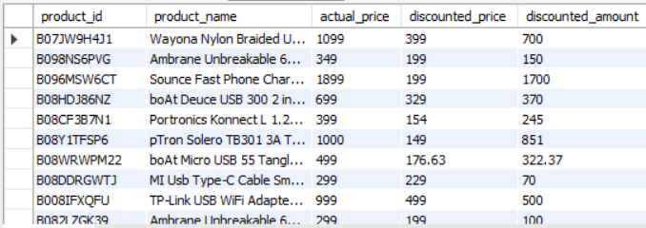
Query to add a new column discount_amount to the products table that calculates the difference between actual_price and discounted_price.

Slide 14
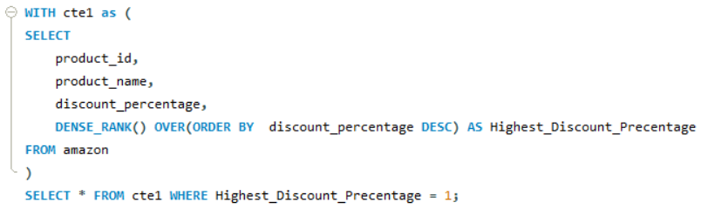
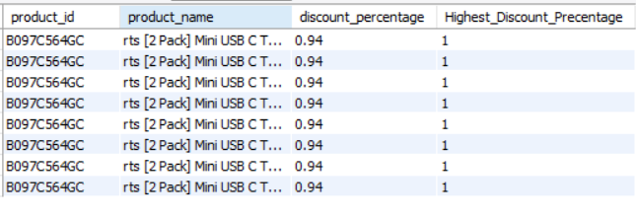
Query using an advanced function to find the product with the highest_discount_percentage.

Slide 15
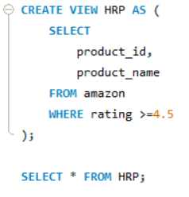
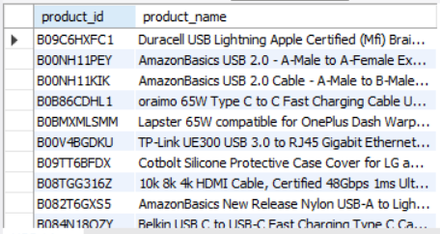
Create a view named High Rating Products (HRP) that includes products with a rating of 4.5 and above.

Slide 16
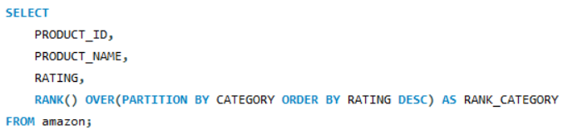
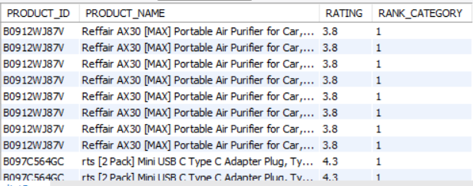
Query using a window function to rank products based on their rating within each category.

Slide 17
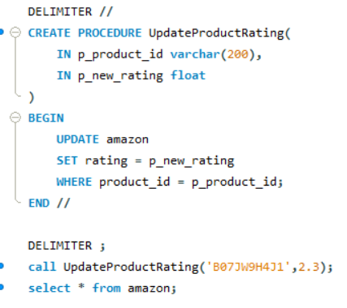
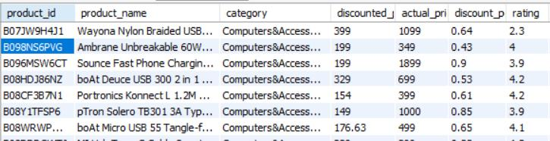
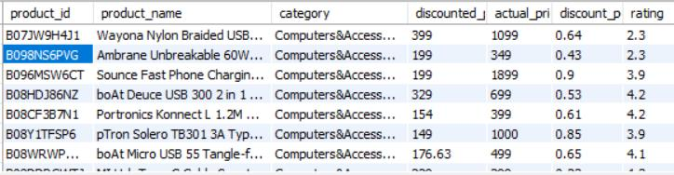
Stored procedure to update the rating of a product given its product_id and new rating
Before
After

Slide 18
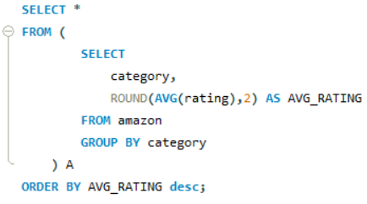
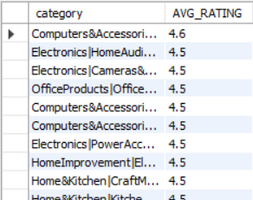

Query to find the category with the highest average rating for products.

Slide 19
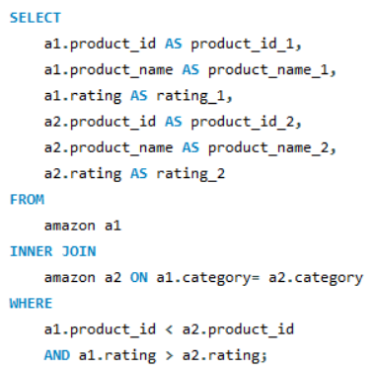
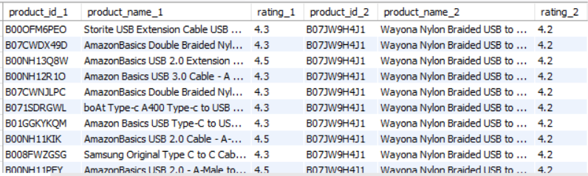
Query to find pairs of products from the same category where one product has a higher rating than the other.

Slide 20
Conclusion
Sales Performance:Amazon has shown consistent revenue growth, with sales peaking during holiday seasons, particularly in November and December. The top-selling categories include Electronics, Home & Kitchen, and Books, which contribute significantly to total revenue.
Customer Behavior: The analysis highlights a high frequency of repeat purchases, particularly among Amazon Prime members, indicating strong customer loyalty.
Product Performance: Best-selling products such as the Amazon Echo and Fire TV Stick drive substantial sales volumes. Seasonal products, including holiday decorations and winter apparel, experience significant sales increases during specific times of the year.

Slide 21
Thank You

